Slide 1
Brisk AI for Education Webinar
10/8/2025

Slide 2
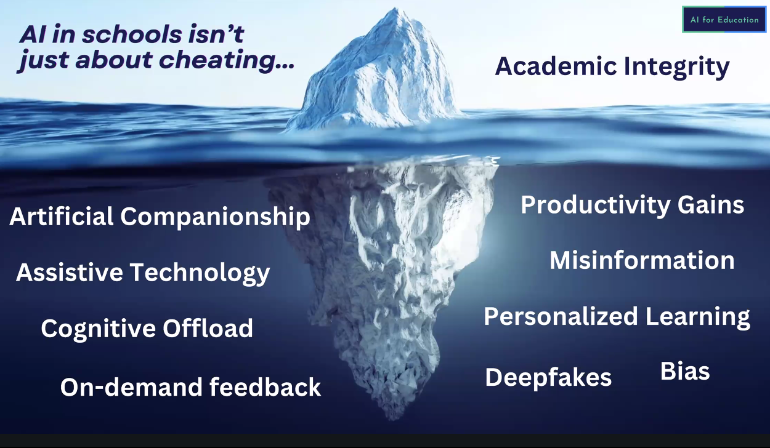

Slide 3
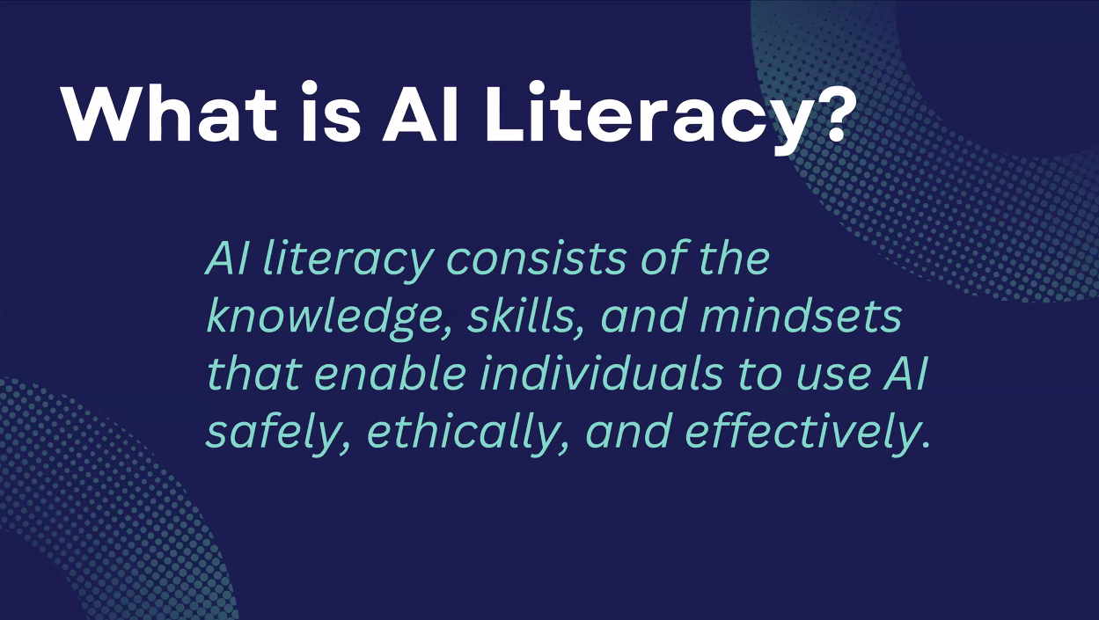

Slide 4
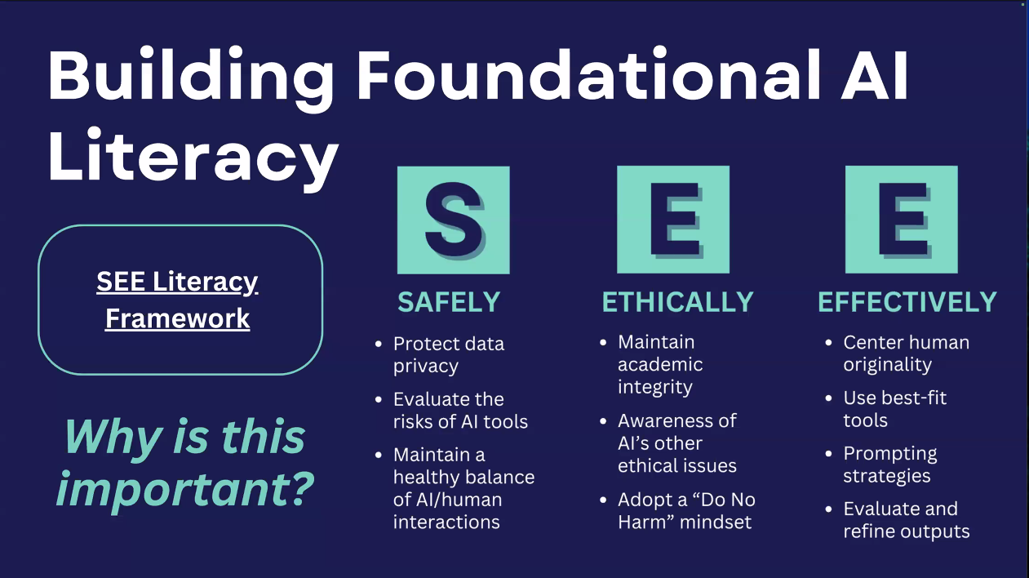

Slide 5


Slide 6
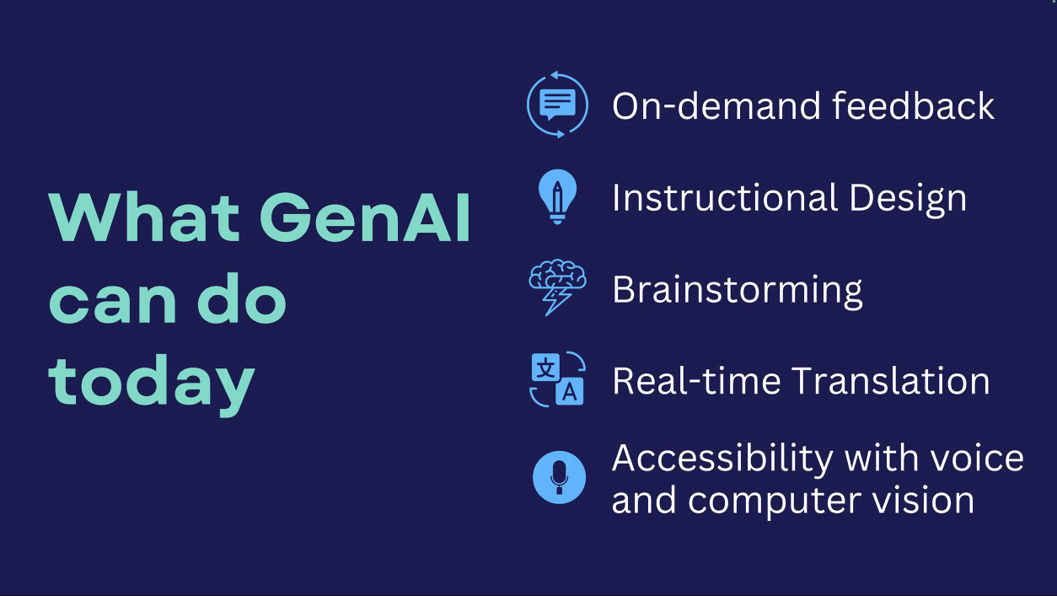

Slide 7
